Slide 1
Disrupting Invisibility –
Hlub Zoo a Culturally Responsive
Mental Health Service
Presented by:
Cheng Vang, MS
Mary V. Her, MSW, LICSW
Notes:
Hlub Zoo
Therapist names

Slide 2


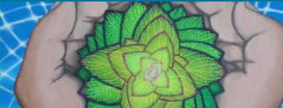
Wilder School-Based
Mental Health
Kofi
(Culturally specific for African American students)
Hlub Zoo
(Culturally specific
for Hmong
students)
Sembrando
(Culturally specific for Latinx students)
Generalists
(For kids of all cultural backgrounds)
Notes:
In 24 school (elementary, middle, high school, HSRA)
Kofi: more than 30 years
Hlub Zoo 10 years
Generalist:
Sembrando: 2 years
(center box)

Slide 3
What we do
Healing through Cultural Knowledge
We provide culturally-affirming, holistic therapeutic services and consultation for children and families in school, home, and community.
How we do it
Excellence in Mental Health Services
Strong, Meaningful Relationships
Cultural Affirmation and Awareness
Notes:
Add sembrando picture/update logo

Slide 4

Our Services
Wilder School-Based Mental Health Providers offer:
  Diagnostic assessments
  Individual and family therapy
  Trauma-informed treatment approaches
  Intensive school-based and in-home interventions
  Care coordination services
  Ongoing consultation for teachers and school personnel
We also work with families to coordinate access
to additional services, including:
  Child and adolescent psychiatry
  Medication management
  Psychological testing
  Basic Needs Support
  Children’s Mental Health Case Management
Notes:
Staff carries a caseload of 16-17 clients
Provide individual/group/family therapy
Provide advocacy
Provide family crisis interventions
Make referrals to other Mental Health Services including community resources
(share own personal stories)

Slide 5

Our Partnership with Schools
As expanded School-Based Mental Health providers & therapists, we:
Partner with existing mental health resources in schools.
Provide ongoing, trauma-informed consultation to staff.
Attend clients’ IEP meetings & other school events.
Help parents connect to the school community.
Notes:
We can make note here of things that we can NOT do. (i.e. consult on specifics of non-Wilder-clients, etc.)
(share stories and collaboration within school)
Life of SBMH therapist
-Serve as a liaison between family, community & school
Facilitate family home visits

Slide 6
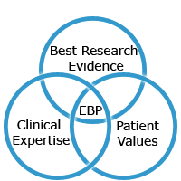
Our Areas of Expertise/Specialized Training
Our Providers are trained in various theories and
Evidence-Based Practices:
  Trauma-informed CBT
  Mindfulness-Based Stress Reduction
  Child-Parent Psychotherapy (CPP)
  Managing Adaptive Practice (MAP)
  Experiential Play Therapy
  YogaCalm
  EMDR
  Systemic Family Therapy

Slide 7

Our Approach: Connecting Inner Life with life in School, Home and Community
School
Family
Community
Behavior
Culture
Culture
Internal world
Culture
7
Notes:
Behavior/internal world: internalize
Model related to school/family/community culture:
Look at student in holistic view, not just behaviors. Understand factors that impact child
Connect client in understanding different system, culture plays role in how mh is viewed

Slide 8
Notes:
10 year anniversary
events

Slide 9
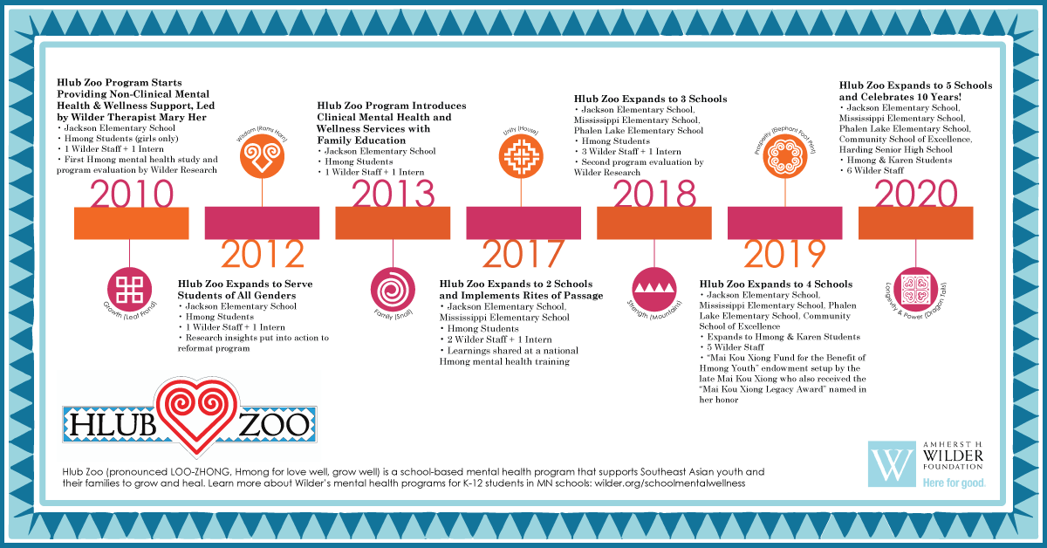
Notes:
Use timeline

Slide 10
Prevalence of Mental Health Issues
 | Hmong community | Total U.S. population
Any diagnosable disorder | 40% to 85% | 20% to 26%
Major depression | 15% to 75% | 7%
General anxiety disorder | 35% to 45% | 3%
Post traumatic stress disorder | 15% to 35% | 4%
Sources: Hang et al., 2004; Kroll et al., 1989; Nicholson, 1997; Westermeyer, 1988; Williams & Westermeyer, 1983; Xiong et al., 2004.
Notes:
JULIE
As background, a review of available literature estimated that the rates of diagnosable mental illness among the Hmong community is likely double or more of the total U.S. population. These elevated rates include many of the more common mental health issues seen in the U.S., including major depression, anxiety, and PTSD (post-traumatic stress disorder).
These estimates of high need not perfect, but they are believable given what we learned. For instance, mental health conditions may be higher for Hmong refugees due to traumatic war and migration.
-comparison between Hmong and general population
-diagnosiable disorder due to issues experience in past few decades (war, trauma, migration, etc.)

Slide 11
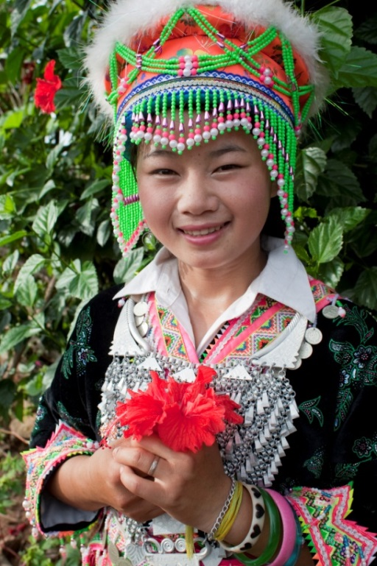
Cultural Influences
Collectivistic society
Family
Religious & Traditional healing
Shame and stigma
"Doctors fix your sickness –
the Hmong way helps your soul.”
– Adult community member
Notes:
JULIE: One of the major findings that emerged, perhaps not surprisingly, was that there are unique cultural nuances that make identifying mental health needs among youth and adults challenging in the western concept of mental health. Before we discuss the complexities, it is important to point out some of the strengths of the Hmong culture as it relates to mental health. First, the Hmong community is a largely collectivistic community, with emphasis on the family and clan structure. Study participants frequently noted the importance of family within the culture, and noted that family or the clan would be the primary source of support for a youth or adult with mental health needs. Additionally, many participants spoke of the value of traditional healing practices, noting that these methods were available in Saint Paul and could be an effective means of addressing some mental health concerns.
These strengths can make identification of mental health needs complex, however. With a strong emphasis on family, there may be reluctance to seek help outside the family/clan structure, making it more difficult for youth and adults in need of greater intervention to be identified or to seek help. Additionally, many participants spoke of challenges in selecting traditional or western mental health services, often due to a tie to family/clan and a desire to work within familiar and trusted cultural practices. Older adults and those who had most recently arrived in the United States are likely to prefer traditional methods; youth from our study were more likely to prefer a western approach. It should be noted that community members and professionals alike felt a combination of approaches may be most beneficial, and some had experienced success using both methods in tandem.
MARY MAY ADD:
-what the traditional healings are, the stigma
Some of the reasons for needing services (This was later – but seems to me it is more about why they are having mental health issues than the rest which is about recognizing and getting services : Youth reported that their parents didn’t think they could experience stress at their age. They also reported they faced pressure to be successful in school and maintain traditional family and gender roles. Additionally, many youth discussed challenges with their roles as cultural bridges for their families. Often children speak English and responsibility for completing paperwork and communicating with teachers and others falls to children.
We learned that when looking at mental health issues, it was important to understand that the Hmong community is largely collectivistic, with emphasis on the family and clan structure. Study participants frequently noted the importance of family within the culture, and that family or the clan are the primary source of support for a youth or adult with mental health needs.
Hmong may be reluctant to seek support from outside their family or clan, for fear of being ostracized or bringing shame to the family or clan. This is especially true in more traditional Hmong households, where there are strict gender roles, and women in particular may feel shameful.
Hmong have traditional healing practices, (what are these?) give examples here. With a strong emphasis on family, there may be reluctance to seek help outside the family/clan structure, making it more difficult for youth and adults in need of greater intervention to be identified or to seek help. Many participants said that there was a desire to work within familiar and trusted cultural practices.
However, we found that the cultural healing methods were more likely to be important to older adults and those who had most recently arrived in the United States are likely to prefer traditional methods; youth from our study were more likely to prefer a western approach.
-what are some strengths and resiliency in our culture?

Slide 12
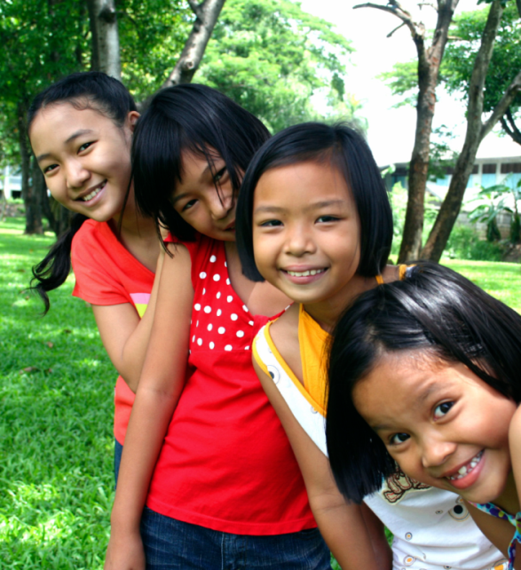
Accessing Mental Health Service Barriers
Cultural and community barriers
  Generational
  Language
  Customs
  Historical trauma
System barriers
  Trust
  Culturally Competent
Notes:
JULIE: There is considerable stigma surrounding mental health issues, and fear of bringing shame to the family/clan as result of mental health challenges. Stigma and shame result in challenges related to confidentiality. Study participants felt that, while it was important to receive services from a Hmong provider, someone who understands the cultural needs of a youth or adult, there were also concerns about maintaining confidentiality if a Hmong provider was used. There was fear that using services would label someone as “crazy”, and that they would bring shame to their families. That said, most study participants, youth and adults, preferred providers who were Hmong.
System barriers exist within the community. Referral processes are complicated as Hmong often display symptoms of mental health in different ways, and usual referral sources, such as primary care or schools, may not ready to identify a Hmong person in need of services. Study participants noted that wait times to get into services can be frustrating, causing families to give up.
Intake and assessment processes can also pose challenges. These processes do not generally allow for a great deal of trust or relationship building; instead eligibility for services is assessed at the first meeting. This can be uncomfortable for many in the Hmong community, and can result in a poor assessment. without trust, the Hmong may be unwilling to disclose sensitive and personal information necessary for the intake and assessment process. We also found current screening tools may not be culturally sensitive and may not identify Hmong in need of services, due to different display of symptoms.
Hmong also face a number of practical barriers in accessing services, similar to many in the community. Barriers include language and limited English proficiency, transportation challenges, insurance and cost of services. We will hear more about how this is dealt with when Mary discusses Hlub Zoo.
-system barriers: mistrust in systems (school, government system, fear), unavailable/inappropriate support/services that are invasive or unsupported

Slide 13
Service Availability
Gaps in available services
  Resources
Early intervention/prevention services
  Crisis
  Risk Factors
  Sites
Lack of culturally competent services
  Bilingual/bicultural providers
Notes:
JULIE: Some of the main resources for mental health supports in the Saint Paul area include Ramsey County, Wilder, and programs at different Hmong-serving organizations. You’ll hear a bit about one of the Wilder programs in a few moments. However, there are important gaps in these and other available services.
Early identification and intervention services are lacking. Hmong families often access the mental health system after a crisis, or after a point at which symptoms have become very severe.
There is also a lack of culturally competent and culturally specific services. Study participants felt that the needs of the Hmong community were best met by Hmong providers, as Hmong providers would be better positioned to take into account Hmong cultural values, cultural expressions of distress, and family dynamics and issues. Along with this, there is a lack of bilingual/bicultural providers within the community. This results in reliance on interpreters, as Hmong clients receive services from non-Hmong providers. Interpreters may not be adequately trained in mental health to adequately support clients and patients through treatment.
-

Slide 14
Disrupting Invisibility
What are the barriers and how can invisibility be disrupted?
Symptoms are presented differently
Psychoeducation
  Social withdrawal
  Feelings of loneliness or guilt
  Somatic symptoms, i.e. headaches and stomachaches
  Not talking to or interacting with others
  Feeling sadness
  Nervousness or irritability
  Fearfulness
  Not standing up for yourself
  Changes in sleeping or eating patterns
  Difficulty concentrating
Notes:
Refer back to some of the model minority sterotypes: submissive, compliant, docile, obedient and naturally smart.
Being withdraw.. describe internalizing behaviors. We received 50 referrals. I’m not saying that all these children have mental illness but we were able to develop a screening system to help identify students who needed further support.
Cultural Education
Psychoeducation
Internalizing vs. Externalizing behaviors
Social withdrawal
Feelings of loneliness or guilt
Somatic symptoms, i.e. headaches and stomachaches
Not talking to or interacting with others
Feeling sadness
Nervousness or irritability
Fearfulness
Not standing up for yourself
Changes in sleeping or eating patterns
Difficulty concentrating
-include consultation with teachers, parents, and clients

Slide 15
Disrupting Invisibility
What are the barriers and how can invisibility be disrupted?
Symptoms are presented differently
Cultural Education
  History
  Acculturation
  Language
Psychoeducation
  Internalizing vs. externalizing behaviors
Collaboration with stakeholders
  Hmong community
  School district
Community engagement
  State/County committees
Notes:
Refer back to some of the model minority sterotypes: submissive, compliant, docile, obedient and naturally smart.
Being withdraw.. describe internalizing behaviors. We received 50 referrals. I’m not saying that all these children have mental illness but we were able to develop a screening system to help identify students who needed further support.
Cultural Education
Psychoeducation
Internalizing vs. Externalizing behaviors
Social withdrawal
Feelings of loneliness or guilt
Somatic symptoms, i.e. headaches and stomachaches
Not talking to or interacting with others
Feeling sadness
Nervousness or irritability
Fearfulness
Not standing up for yourself
Changes in sleeping or eating patterns
Difficulty concentrating
-project Tsav Ntuj,
-community engagement: RC childrens mental health advisory committee, county support for fundings

Slide 16
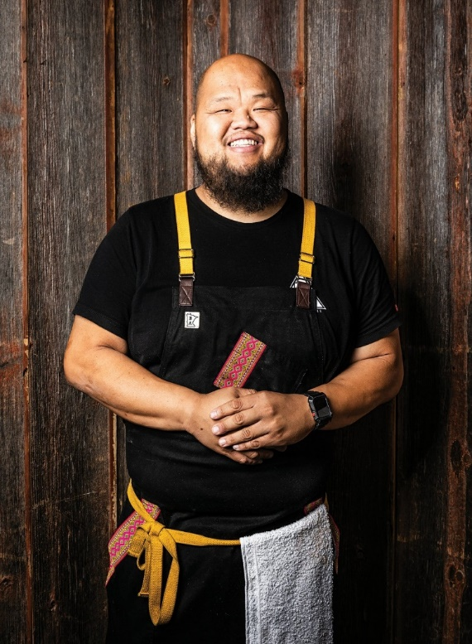
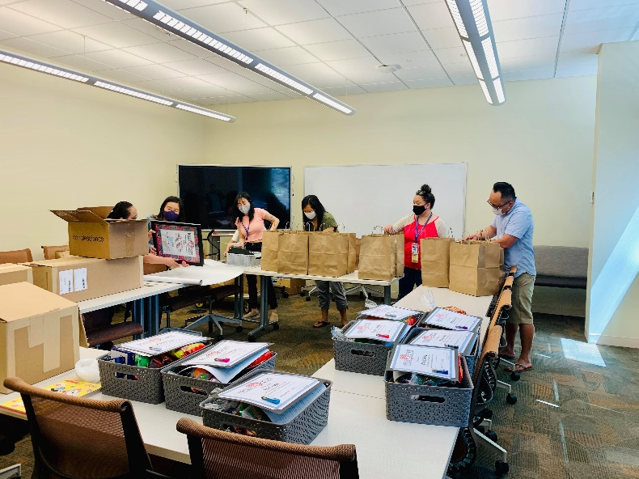
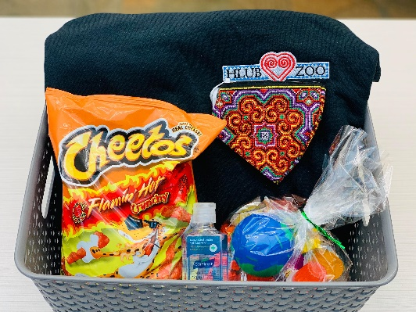
Rites of Passage
Culture takes center stage as fifth grade students are supported in strengthening cultural identity and connections with students from other Hlub Zoo sites.
Cultural Education
  History
  Language & Music
  Traditions
Hmong Artists
  Music
  Art
  Culinary
Notes:
Focus on rop

Slide 17
Karen Cultural Broker
  Providing content expertise to shape trainings for clinical staff
  Offering one-on-one coaching/observation of our cultural brokers as they test their new skills and workflows
  Consulting with clinical leadership to more clearly define the cultural broker job description, referral process, and service menu
  Providing content expertise to shape trainings for cultural brokers, both new and experienced
Notes:
Girls have to love one self, family, future, culture

Slide 18
Purpose and Goals
Hope for their future
Parent engagement
Positive cultural identity
Healthy relationships
SUCCESS IN SCHOOL, AT HOME
AND IN THE COMMUNITY
Notes:
Girls have to love one self, family, future, culture

Slide 19

Teacher Feedback
“Yes we have systems, but [the Wilder therapist] brings the thunder…I don’t want to downplay what the school does, but we don’t have the time and resources…A lot of what we do can be reactive to behaviors. We try to have it be proactive, but there are just not enough supports. [The Wilder therapist] is the major proactive piece that’s nurturing the children in what they need to avoid some of the behavior issues.”
(Wilder Research, 2015, LSF Report)
Notes:
Add student quote

Slide 20

Reflecting on Student Growth

Slide 21
Questions?
We are looking forward to another year of meaningful service and collaboration to support students, families, and the school community.

